Slide 1
Data Analytics-Introduction
by
V.Rojasri

Slide 2
Contents
Introduction
Types of Data Analytics
Importance of Data analytics
Conclusion

Slide 3

Introduction
Data analytics is the science of
Analyzing raw data to make
Conclusions about that information.

Slide 4
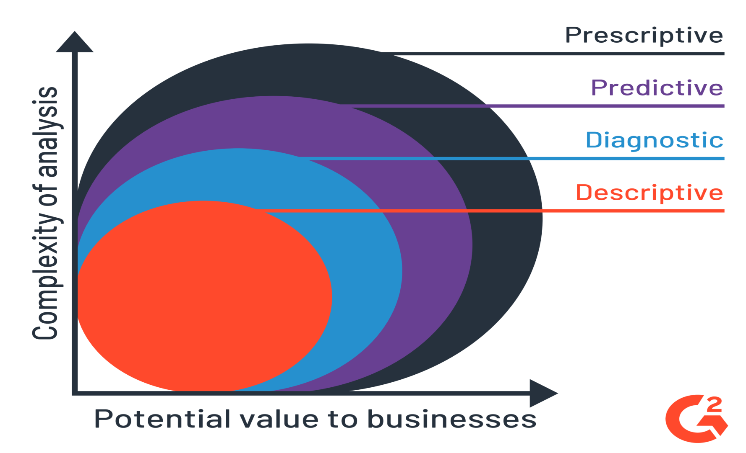
Types of Data Analytics

Slide 5
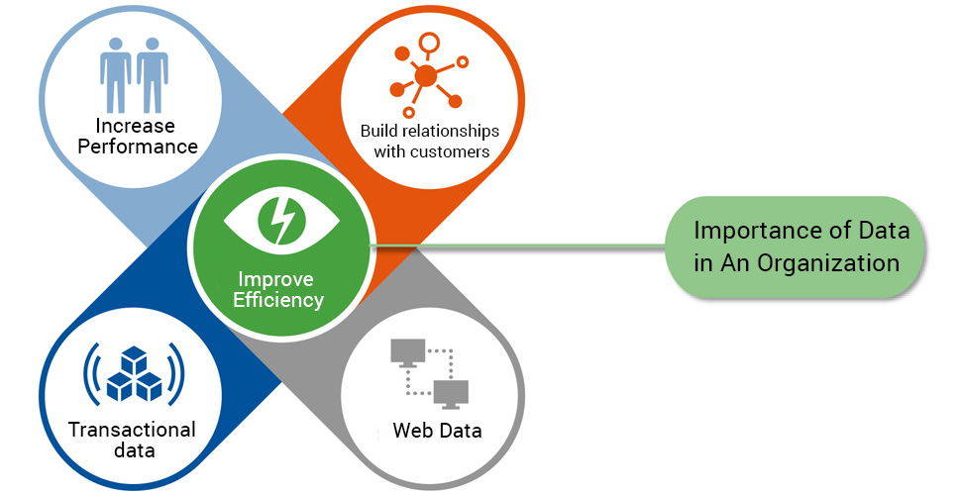
Why is Data Analytics Important?
Data analytics is important
because it helps businesses
optimize their performances.
Implementing it into the
business model means companies
can help reduce costs by identifying
more efficient ways of doing business.

Slide 6
Conclusion
Data analytics is a process of analyzing raw datasets in order to derive a conclusion regarding the information they hold.

Slide 7
Thank you
Presented by
V.Rojasri

